Slide 1

VOTING PREDICTIVE MODEL
Anthony, Govarthini, Jayashree & Marina

Slide 2
PROJECT OVERVIEW
INTRODUCTION
IMDb (Internet Movie Database) is the world most popular online database of information related to films, television series, podcasts ratings, and fan and critical reviews.
INITIAL APPROACH
To implement machine learning models in order to predict accurately IMDB ratings of any particular movie.
After experimenting with the different regression models we found that none of them were giving the expected results for predicting IMDb rating score.
FINAL OBJECTIVE
We shift our attention into forecasting the number of votes for each film which is also an indicator of a film success in terms of popularity.
For this purpose, the relevant data that has been used is information about movies ratings, directors and star names, duration and other features that might influence the number of votes obtained by the public.

Slide 3
PROCESS OVERVIEW
Data Selection and Preparation
Round 1:
Feature engineering
Model testing
Round 2:
Feature selection
Model testing and final model selection
Final model optimization

Slide 4
Data Selection and Preparation
Dataset link: https://www.kaggle.com/datasets/harshitshankhdhar/imdb-dataset-of-top-1000-movies-and-tv-shows/data
Original IMDb Rating data set : 16 columns x 1000 rows
Data cleaning ( casting data types, dropping null values, deleting columns )
Cleaned IMDb Rating data set : 14 columns x 715 rows
Data exploration and visualization
Pre Processed the data in order to implement ML models
Regroup categorical variables (mapping) - actors or film genre.
Scale numerical features

Slide 5
2a. Feature engineering and selection
Train test split: Setting our target column (Number of votes) and pre-selecting the rest of the features that needed to be considered - Movie director, critic’s score or film categories.
OneHotEncoder: Utilized this function in order to categorize categorical values into numerical, enabling the performance of ML models.
Normalize all the values by using the MinMax Scaler.

Slide 6
2b. Model Testing
The first round of model testing involved basic versions of the major regression machine learning models:
KNN
Linear Regression
Decision Tree / Random Forest
In addition, basic ensemble approaches were utilised:
Bagging and Pasting
Ada boosting
Gradient Boosting
The metrics used to compare models are:
r2_score
mean_absolute_error
mean_squared_error

Slide 7
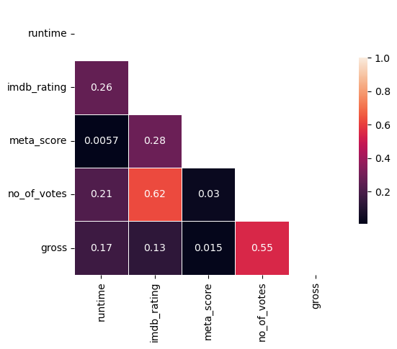
3a. Feature Selection
Initial approach was to utilize all the different features of the data set and perform trials with the different models to see the results.
After testing we dropped :
Meta_score (critics) - low levels of correlation.
Star categories 2, 3 and 4 (casting) : Categorical values - discarded after testing.

Slide 8
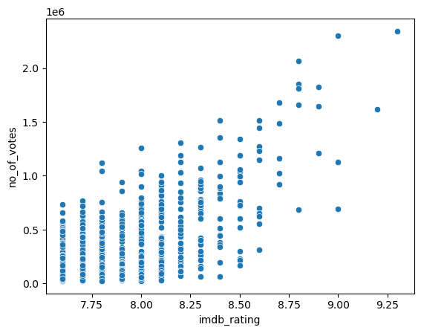
A closer look at the Rating: Votes correlation

Slide 9
3b. Model Testing and selection
This involved the same steps and models used in the first round of model testing, but with a more refined set of features.
In addition, initial parameter tuning was implemented.
Ultimately, the GradientBoostingRegressor performed the best and was selected for final tuning.

Slide 10
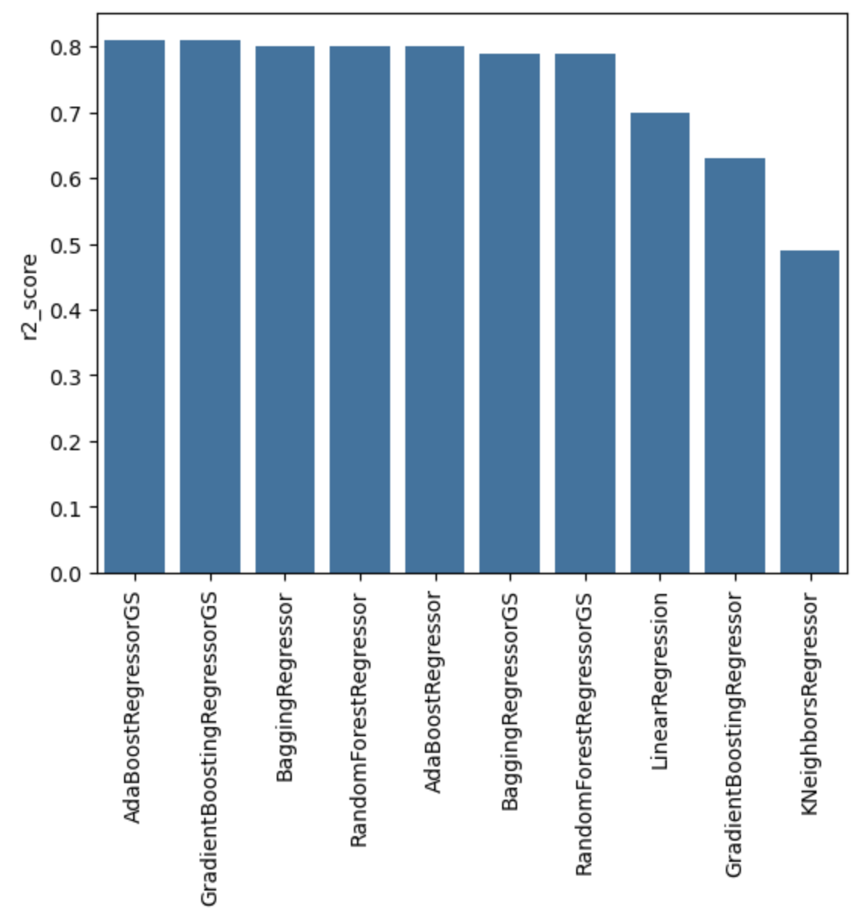
3b. Model Comparison
The GradientBoostingRegressor and AdaBoostRegressor performed equally on R2 Score, but Gradient Boosting performed better on the other metrics.

Slide 11
4. Final model optimization
Hyperparameter tuning technique: GridSearchCV
Tuning process:
Run each adjusted model to retrieve metrics and best parameters
Add metrics and best parameters to a “scorecard” data frame for later comparison
Continually adjust parameters based on the results in the scorecard and repeat
The final metrics:
R2 Score: 83%
Mean Squared Error: 155,177.32
Mean Absolute Error: 110,789.33
Notes:
The range in no_of_votes is 2,317,881

Slide 12
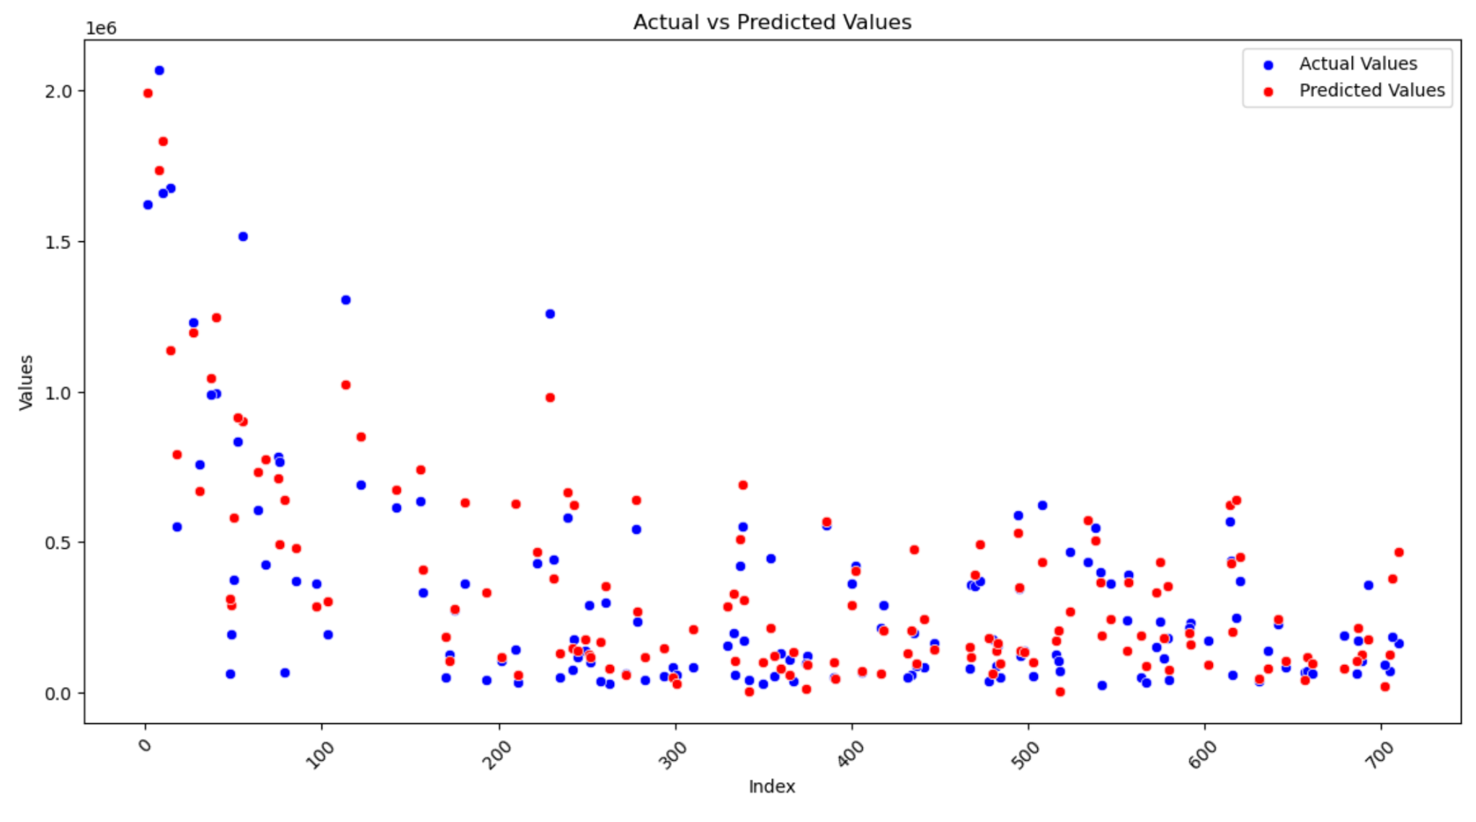
Notes:
The range in no_of_votes is 2,317,881

Slide 13
Challenges & Learnings
Data set: Too many unique values in categorical columns
Initial approach: Could not achieve highest rate for imdb_rating, ended up moving to no_of_votes column
Predictive models : Understanding the relationships between the different features , how each model performs and interpreting the results.

Slide 14
Real-World Application and Impact
The global movies and entertainment market size was estimated at over USD 100 billion in 2023, expecting to grow at 8% during the current year.
Our model is developed on a real world data set and can also be used to predict user’s votes in other platforms such as Rotten Tomato or Metacritic. Other than films, TV shows or music shows popular votes could also be predicted using our model.
Forecasting the number of votes that a movie could obtain is a metric that may be also utilized to create a social media marketing strategy for a production company or streaming platform.

Slide 15
THANK YOU !
Anthony, Govarthini, Jayashree & Marina

